Slide 1

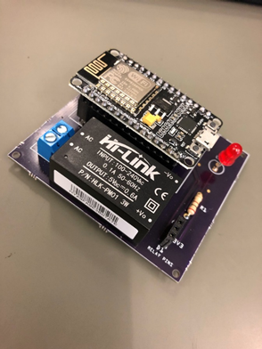
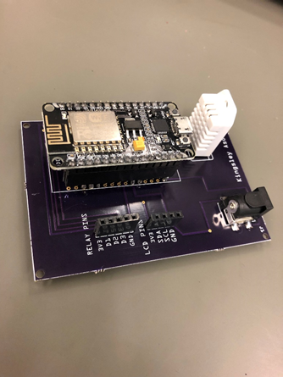
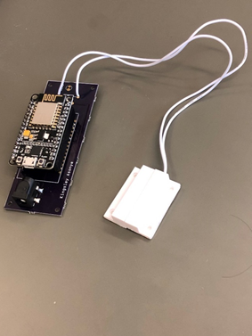
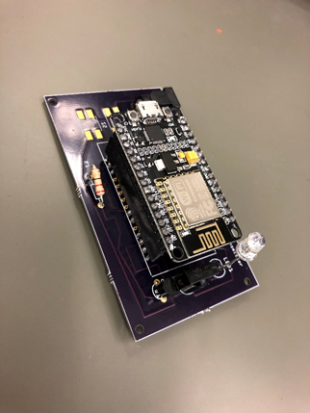

Developing Smart Home with Internet-of-Things Technologies
Speech recognition through Amazon Web Service (AWS).
Voice commands to appliances, such as TV, thermostats, etc.
User customized functions.
Open/Close Detection System
NDUBUISI IWUALA
KINGSLEY ASONYE
Room 1088
Easc building
may 13th , 2019

